Slide 1

SMART 4.0 COMPETITION
Business Proposal - Team 26

Slide 3
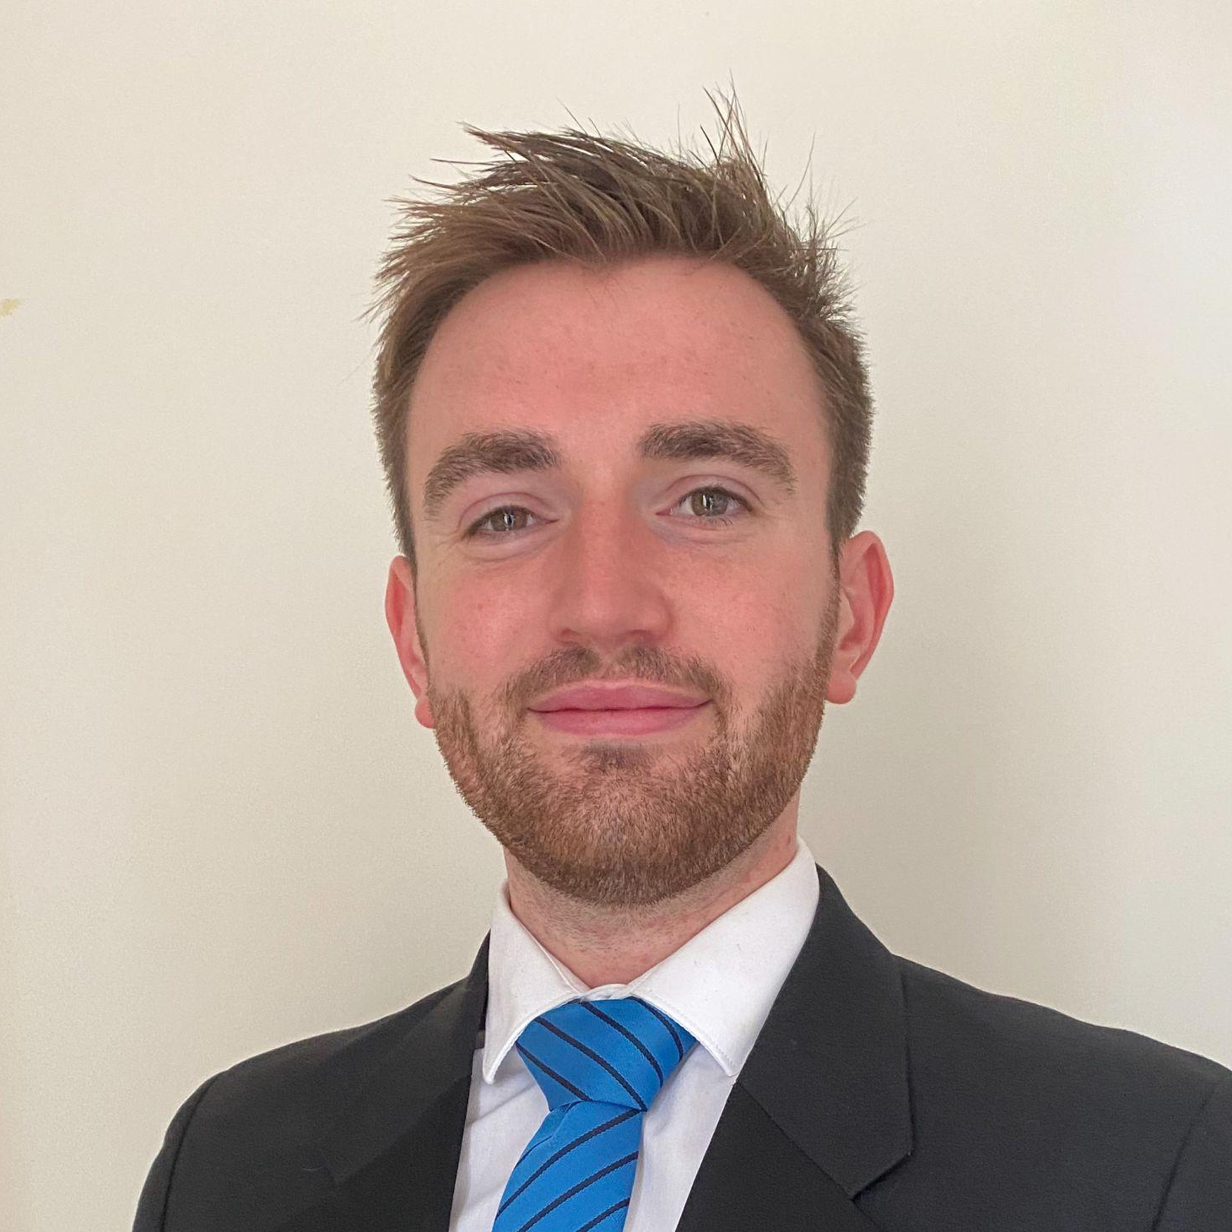
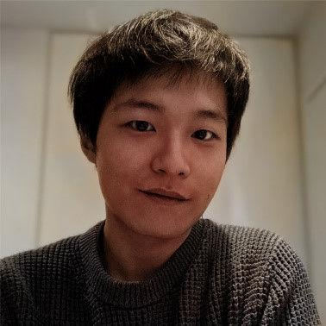
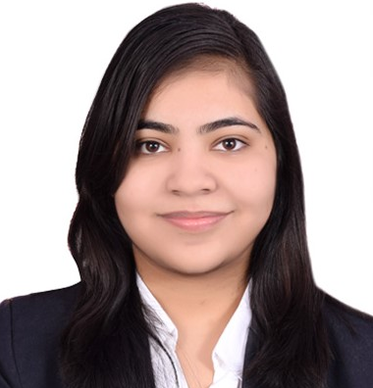
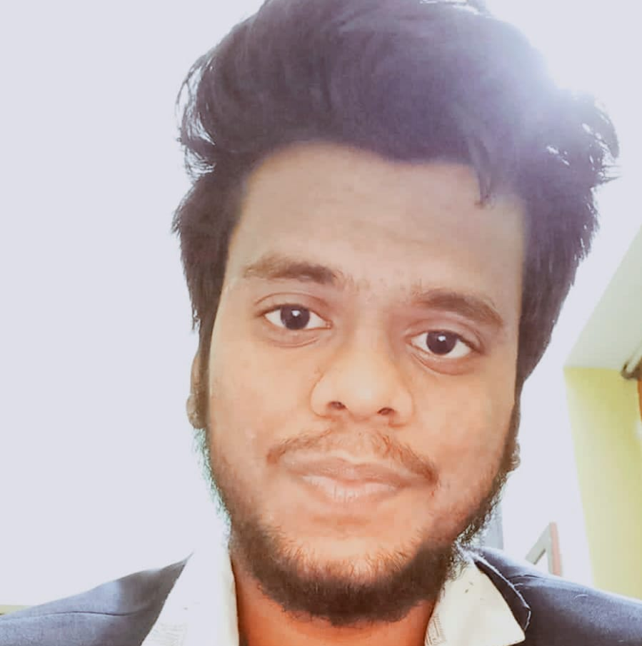
Team Introduction
Ewan Atkinson - CEO
Exchange@NTU
Xinzhi Liu - CMO
NTU
Vidhi Patidar - CTO
IIT Roorkee
Pranavv Haran Nagarajan - CFO
SRM chennai
Notes:
Explain what we do in our roles
Discuss our experience / background, how we can develop a good brand
Discuss the brand direction, as we grow we will invest in our technology department for which Vidhi is the CTO, this will be discussed later on
our brand direction (researching the potential of emerging technology to identify innovative food waste management solutions)
Role of the CTO is to identify emerging technology and adapt it to develop smart food waste management solutions

Slide 4
Problem Description
Food waste is an escalating global problem that significantly impacts climate change throughout the product life cycle.
Nearly one-third of all food produced worldwide is discarded
Throwing good food away to landfills wastes money and produces methane gas, a greenhouse gas contributing to climate change
Notes:
Delve more into the problem at school cafeterias

Slide 5
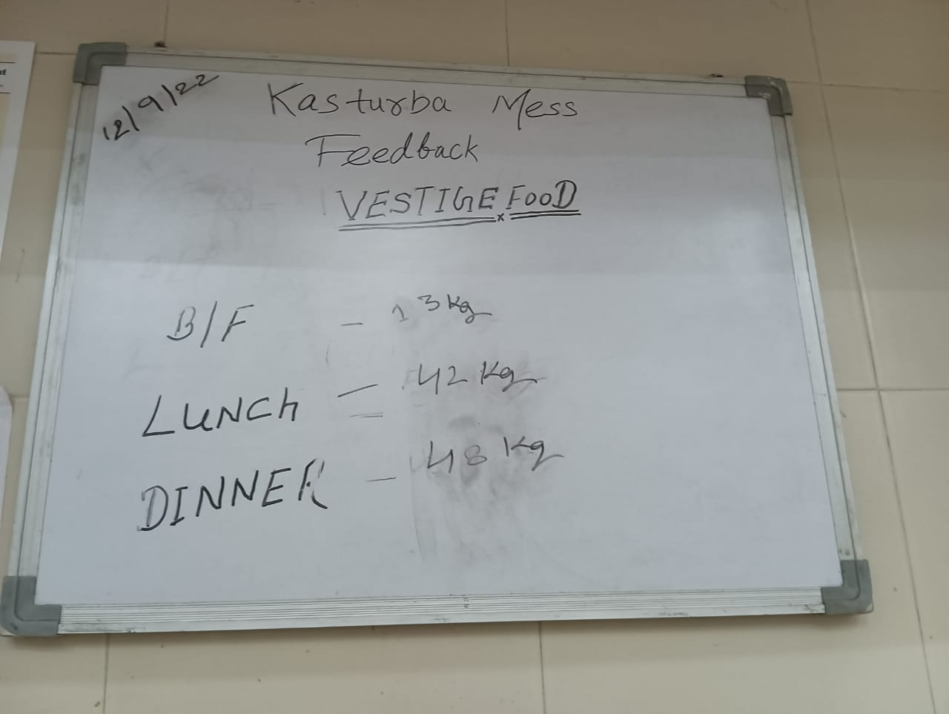
Problem Description
Food waste in hostel mess
Wasted globally with 53% of food waste coming from Asia
Students skills means in which they find the menu not appealing, but nevertheless mess administration cooks meal for all students
Extra amount of food taken in plate doesn’t get discarded properly
Students pay for meals they are not having
Fig: Amount of food waste in one hostel mess of IIT Roorkee in a day

Slide 6
There is a clear need to find sustainable solutions to alleviate the impact

Slide 7


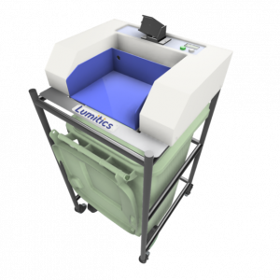
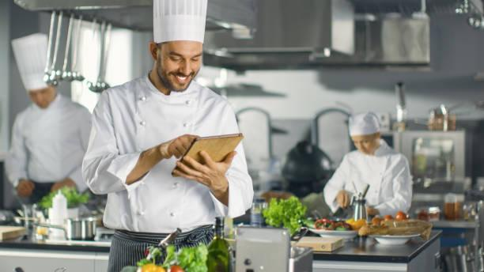

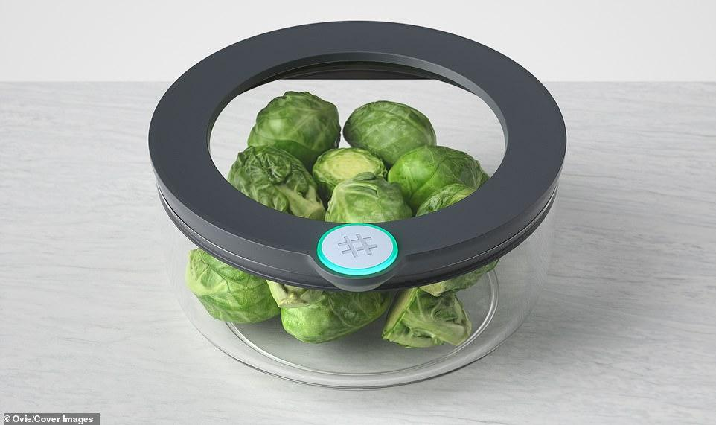
Our Solution
SMART Bin
Mobile Application
Services
SMART Container

Slide 8
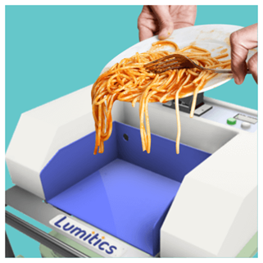
Products and Services
SMART Bin
AI food tracking creates a leaner approach to understanding food consumption in dining halls,
Enables customers to optimise production, preserve yield rates, make more intelligent purchasing, and informs menu engineering.

Slide 9
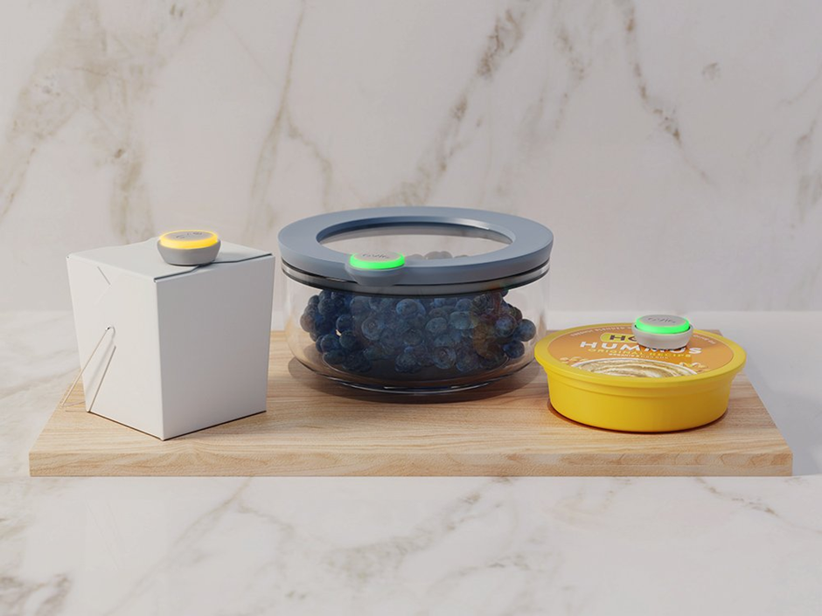
Products and Services
SMART Storage
Offer greater control over storage environments and track food expiration.

Slide 10
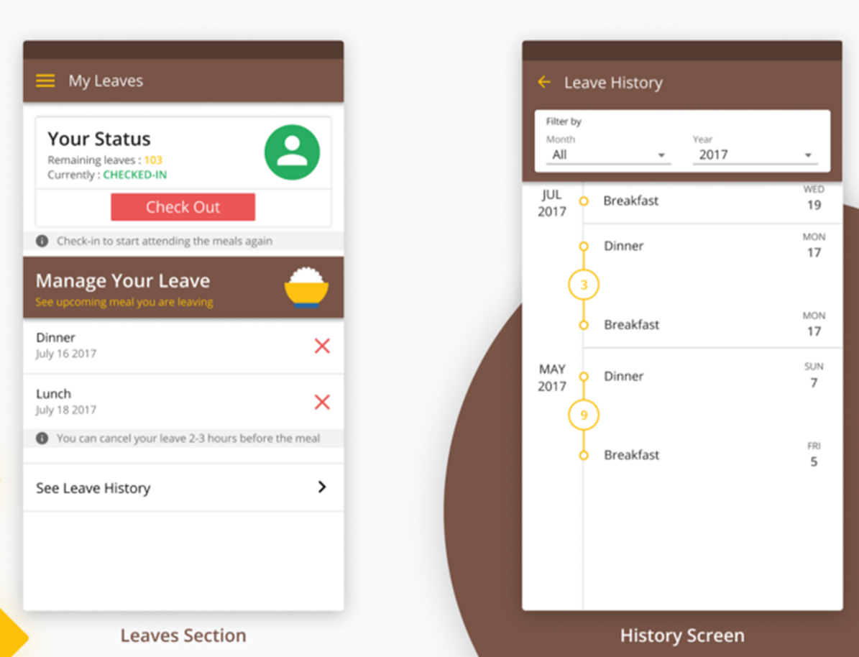
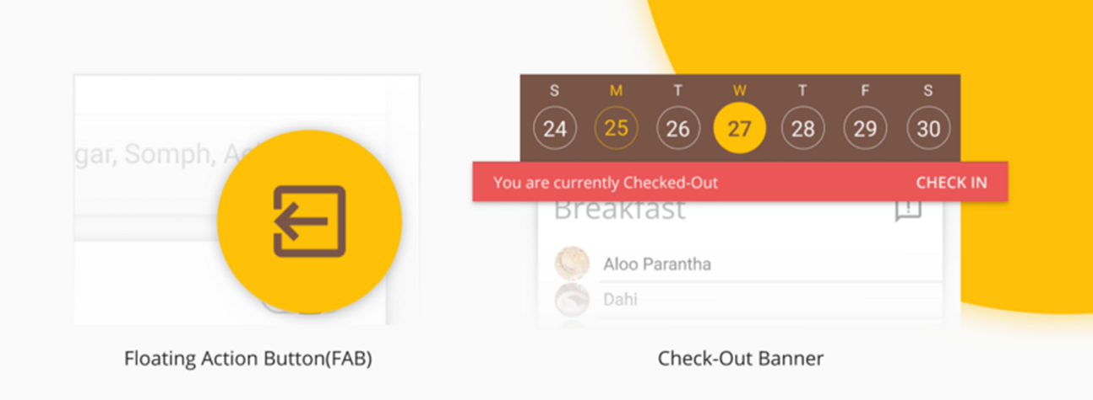
Products and Services
Mobile Application
AI Connects customers directly to the products and consumers.
Provides key performance metrics to understand food waste management strategies and optimise one’s business based on consumer demand.
Students get refunded for the meals they don’t have

Slide 11
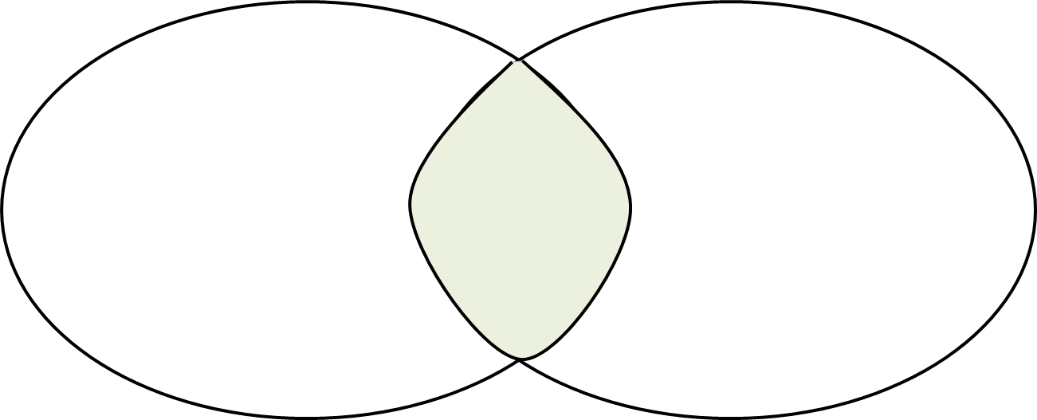




Competition
ATUP are focusing on a niche market
Food waste management
Dining hall food management
Traditional procurement and maintenance method
Notes:
Point about entering market with little competition (blue ocean), we will become the market leaders early on
There is strong research that proves the potential for growth in less developed countries, showcases opportunities for cost savings, demonstrates the effectiveness of technological solutions to tackle food waste problems
[Look through report for what research supports this]

Slide 12



Competitive Advantage
Out-of-the-box solution
Digitalized
Cost-friendly
Provide the cost-friendly food management services
Offer user-friendly products and services
Create the digitally customized food waste solution
Notes:
Our products is

Slide 13
Market Validation
8,323M
TAM
343M
SAM
5M
SOM
CAGR : 5.7%

Slide 14




Business Model
Hybrid business model
Schools
.
.
.
Food waste solution
Subscription
AI products manufacturers
Transaction fee revenue model + Subscription model
Notes:
What is our model, i.e. where does the revenue come from, how do we use it

Slide 15
Business Model
ATUP makes money in 2 different ways
$ 45-60
10%
Monthly subscription
Transaction fee
ATUP charges $45-60 per month
We make 10% on every transaction made from SMART product manufacturers
Notes:
What is our model, i.e. where does the revenue come from, how do we use it

Slide 16
Go-to Market
Where does our brand name, ATUP, originate?
Our company motive: to minimise food waste using smart technology
At ATUP, we provide forethought, envisioning and a frugal culture

Slide 17
Financials
We are looking for startup cash to reach 3 Lakh Fans
65k
Seed Round
3L
Transactions
3.9L
Revenue over 5 Yrs
In US dollars $
Break even point between 4-5 years

Slide 18
Financials
Activities | Cost
For Developing website & APP | 15k
Employee Salaries | 15k
General Administrative Cost | 5k
Marketing & Promotion for 5 years | 20k
Research & Development | 5k
Miscellaneous | 5k
Total | 65,000
In US dollars $

Slide 19

Fundraising Information
Initial investment of $65k
Revenue is generated via a subscription basis
Return on investment
Notes:
Find investors who will help us purchase products first, then any revenue will go back to funding more products. Additional revenue will go back to the investors. Once we have sufficient revenue that we pass the break-even point, the profit will be put into our technology department to enhance our market knowledge

Slide 20

Brand Direction
Potential for Growth
Our proposal supports the UN's goal to halve global food waste by 2030
We will invest in more advanced technologies and partner with developers to create more effective solutions that address clients' specific needs
Notes:
Addressing food waste management in less developed countries:
[Use Indonesia case study from business proposal report]
Ensures the food available is optimally used
Contributes towards a zero-waste culture
Building our brand image working with schools in less developed countries and universities that promote a sustainable campus culture

Slide 21
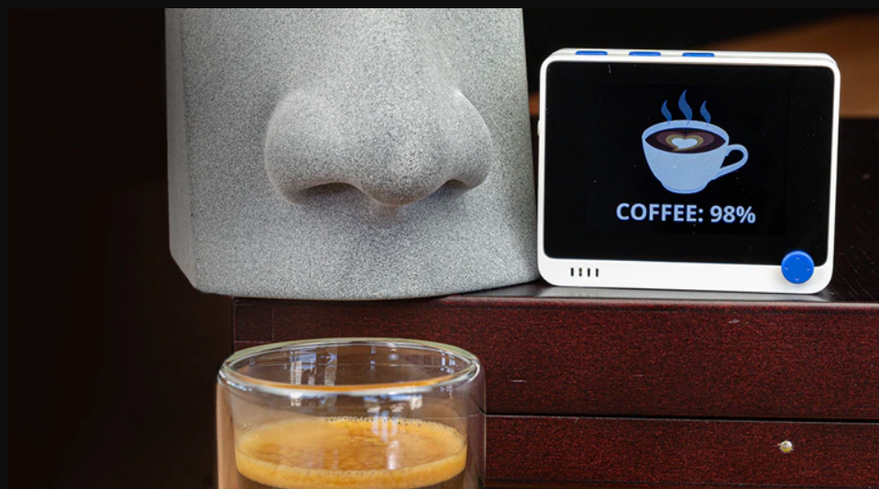
Brand Direction
Pioneering SMART Food Waste Solutions
Role of the CTO
At the forefront of emerging technology
Seeking opportunities
Pushing sustainability
Driving innovation in this market
Artificial Intelligence Nose
Notes:
Role of the CTO

Slide 22




Closing Remarks
Unique Selling Points
Upholds the Qualities of a Circular Bio-Economy
Putting Emerging Technology at the Forefront
Addressing the Needs of the Developing World
Enabling Customers to Optimise their Businesses
Notes:
Add point about when this technology is available we will be the market leaders
It is not a case of whether these technologies will find their way into this industry, rather it is when. We aim to get started now so we can get to the forefront before the technology is more mainstream
Entering a market with little competition, working our way into a market with massive competition, using our own solutions to stay relevant in the market

Slide 23

Thank you!
“The greatest threat to our planet is the belief that someone else will save it."
Robert Swan, OBE, FRGS

